Slide 9
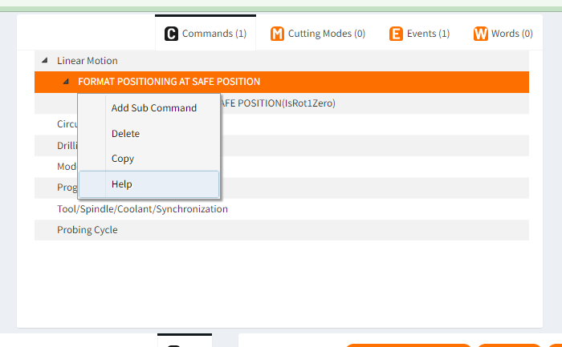
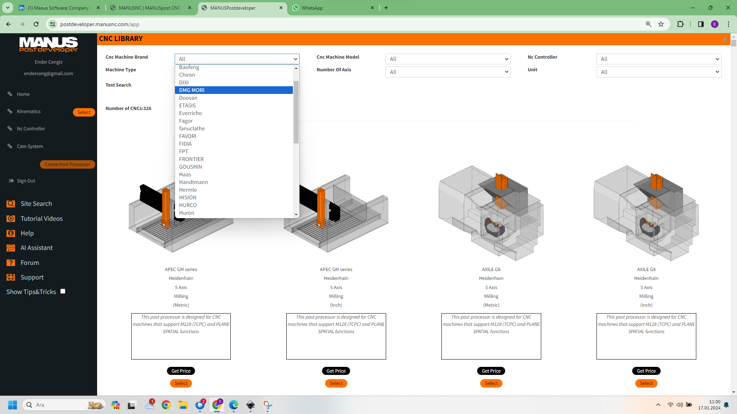
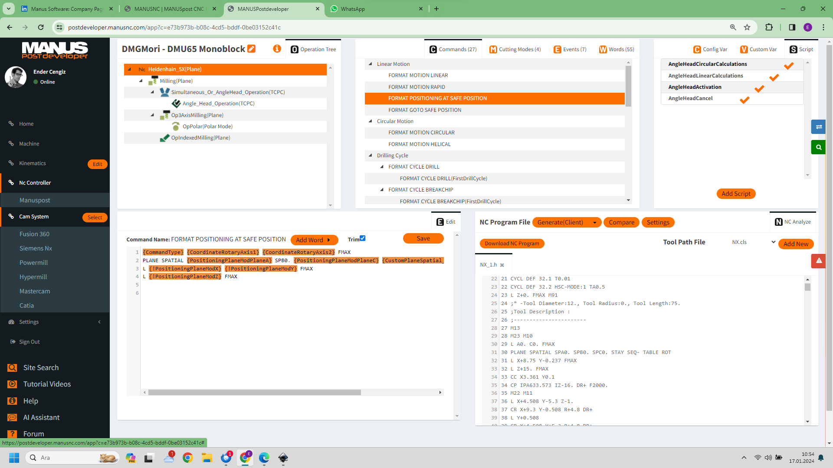
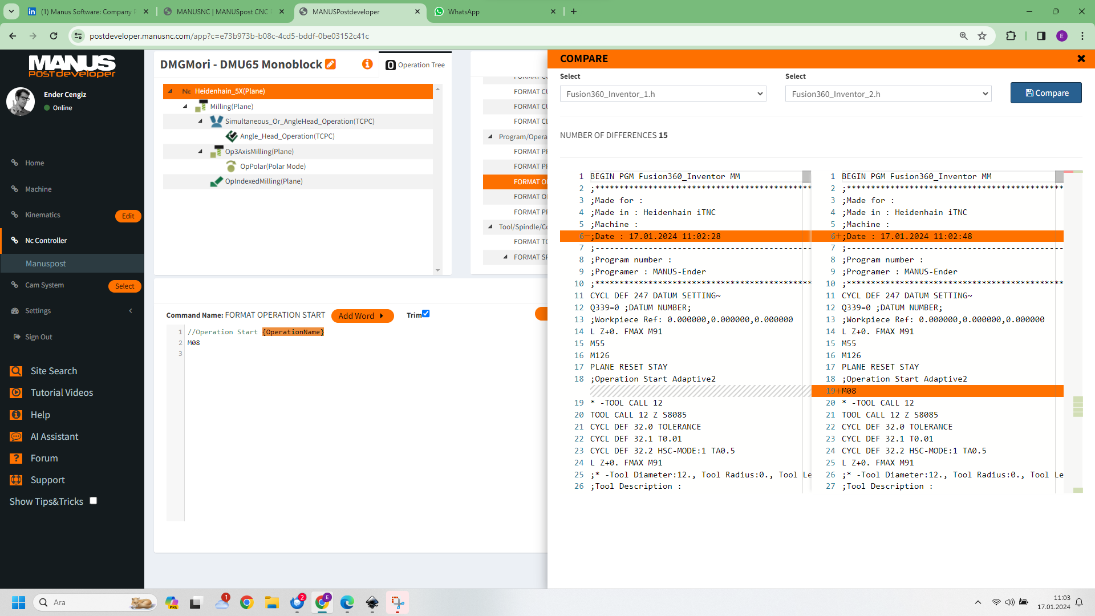
What Is
Easiest CNC Post Processor Solution
Huge CNC Post Processor Library
Not Only A Post Processor Editor
Everything In One Screen

